Slide 1
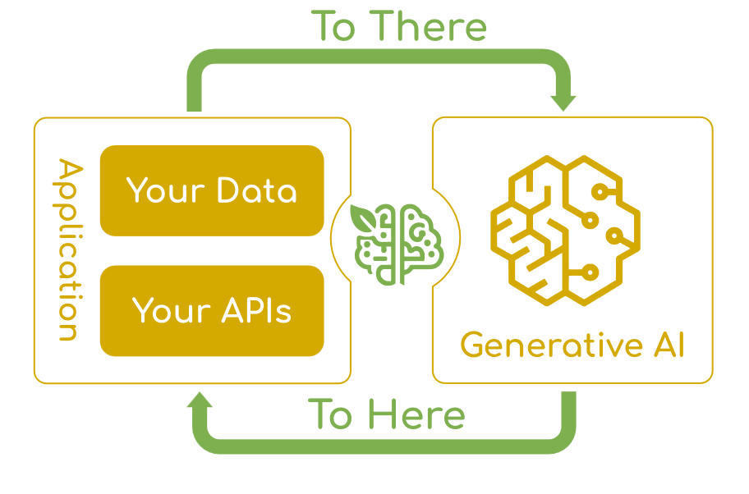
Spring AI
Spring AI is an application framework for AI engineering.
Its goal is to apply to the AI domain Spring ecosystem design principles such as portability and modular design and promote using POJOs as the building blocks of an application to the AI domain.
At its core, Spring AI addresses the fundamental challenge of AI integration: Connecting your enterprise Data and APIs with the AI Models.

Slide 2
Spring AI provides the following features:
Support for all major AI Model providers such as Anthropic, OpenAI, Microsoft, Amazon, Google, and Ollama.
Supported model types include:
Chat Completion
Embedding
Text to Image
Audio Transcription
Text to Speech
Moderation

Slide 3
1. Chat Model API
The Chat Model API offers developers the ability to integrate AI-powered chat completion capabilities into their applications.
It leverages pre-trained language models, such as GPT, to generate human-like responses to user inputs in natural language.
The API typically works by sending a prompt or partial conversation to the AI model, which then generates a completion or continuation of the conversation based on its training data and understanding of natural language patterns.
The completed response is then returned to the application, which can present it to the user or use it for further processing.

Slide 4
The Spring AI Chat Model API
The Spring AI Chat Model API is designed to be a simple and portable interface for interacting with various AI Models, allowing developers to switch between different models with minimal code changes.
This design aligns with Spring’s philosophy of modularity and interchangeability.
Also, with the help of companion classes like Prompt for input encapsulation and ChatResponse for output handling, the Chat Model API unifies the communication with AI Models.
It manages the complexity of request preparation and response parsing, offering a direct and simplified API interaction.

Slide 5
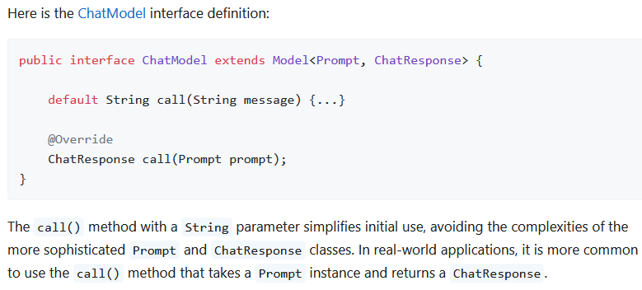
ChatModel

Slide 6
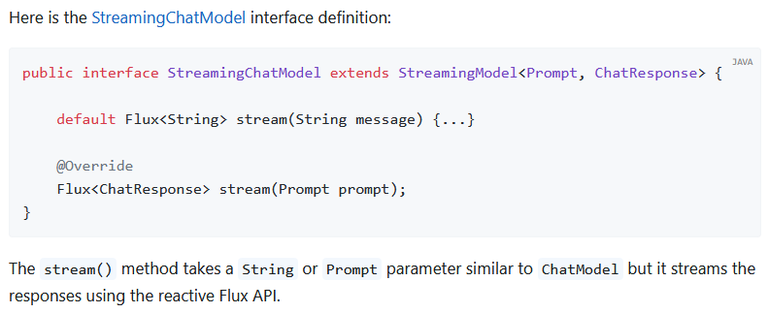
StreamingChatModel

Slide 7
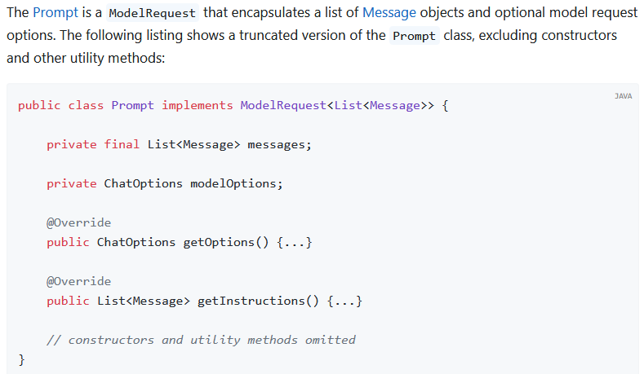
Prompt

Slide 8
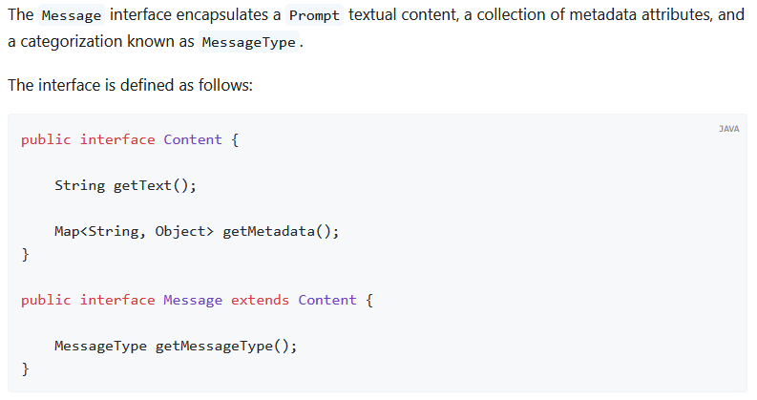
Message

Slide 9
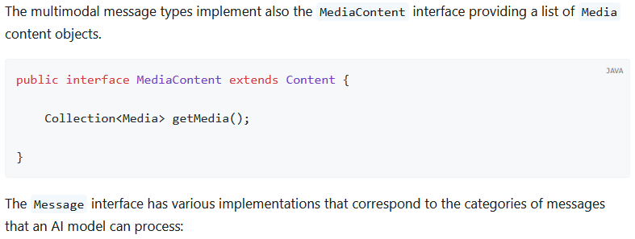
MediaContent

Slide 10
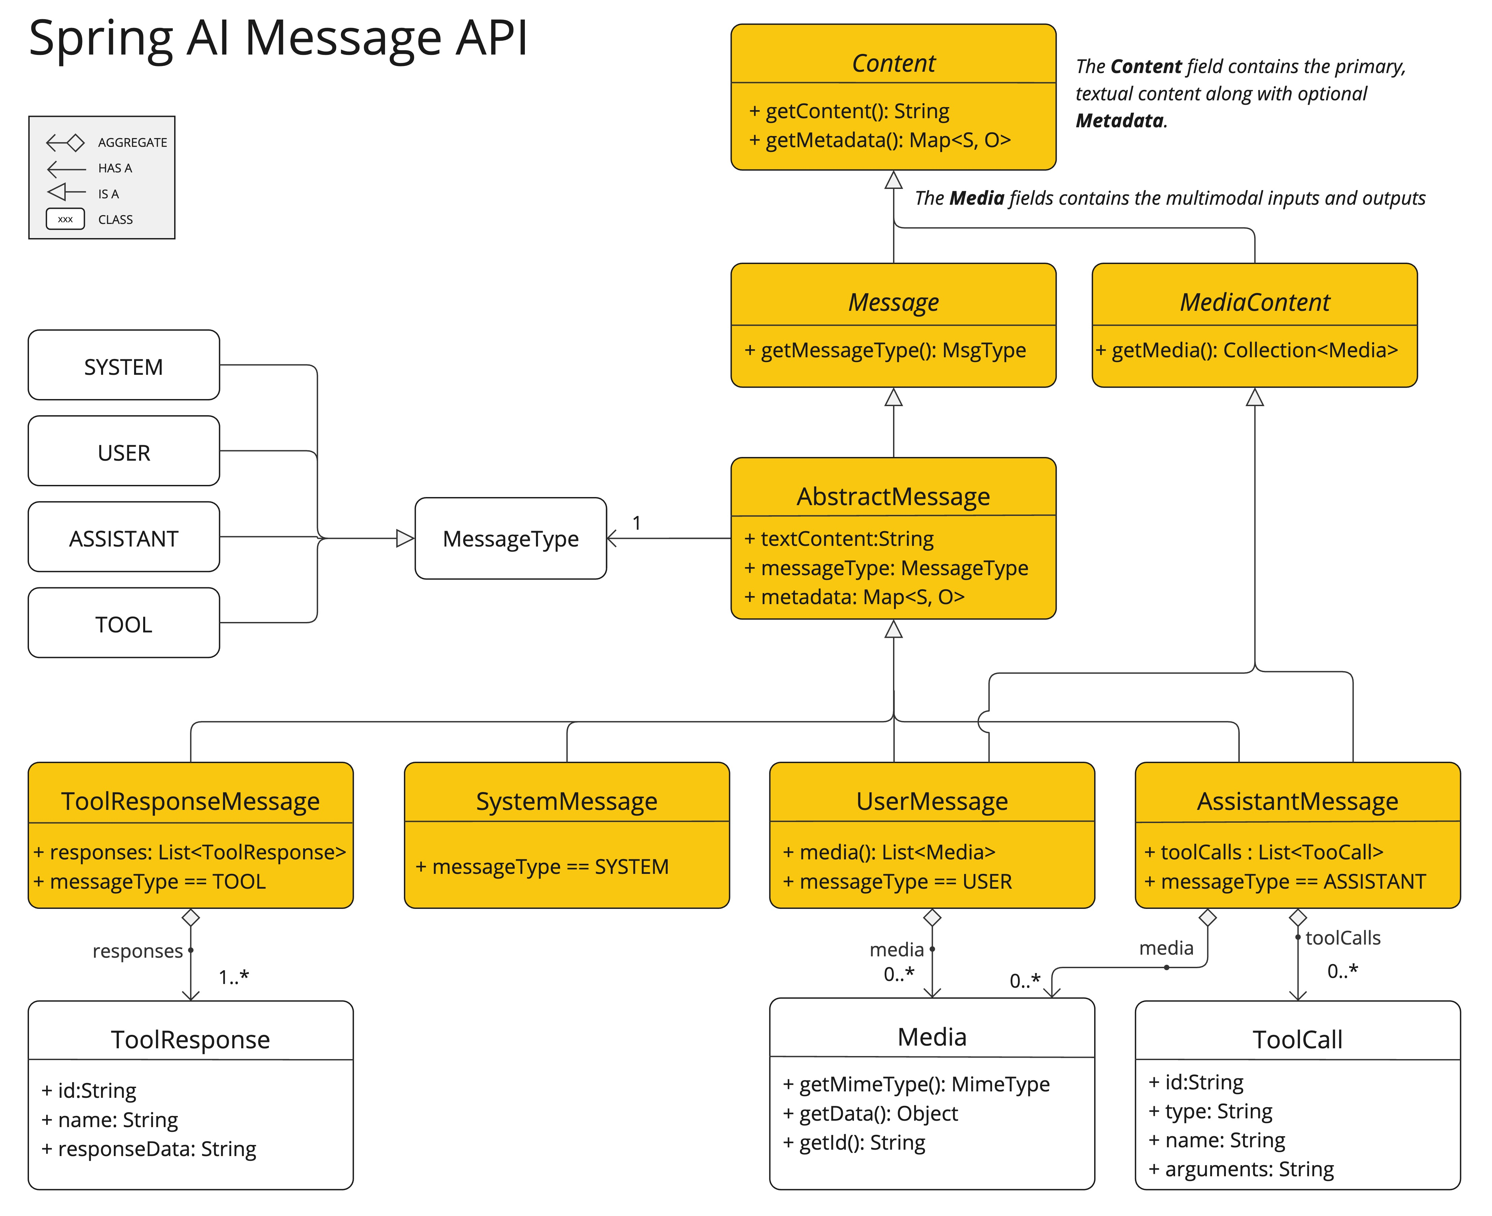

Slide 11
Spring AI Message API
The chat completion endpoint, distinguish between message categories based on conversational roles, effectively mapped by the MessageType.
For instance, OpenAI recognizes message categories for distinct conversational roles such as system, user, function, or assistant.
While the term MessageType might imply a specific message format, in this context it effectively designates the role a message plays in the dialogue.
For AI models that do not use specific roles, the UserMessage implementation acts as a standard category, typically representing user-generated inquiries or instructions.

Slide 12
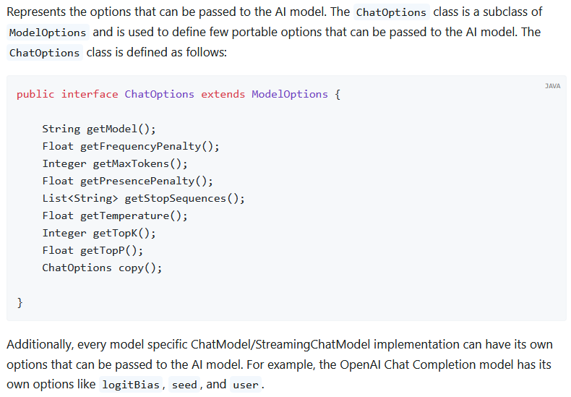
ChatOptions

Slide 13
Spring AI provides a sophisticated system
Spring AI provides a sophisticated system for configuring and using Chat Models.
It allows for default configurations to be set at start-up, while also providing the flexibility to override these settings on a per-request basis.
This approach enables developers to easily work with different AI models and adjust parameters as needed, all within a consistent interface provided by the Spring AI framework.

Slide 14
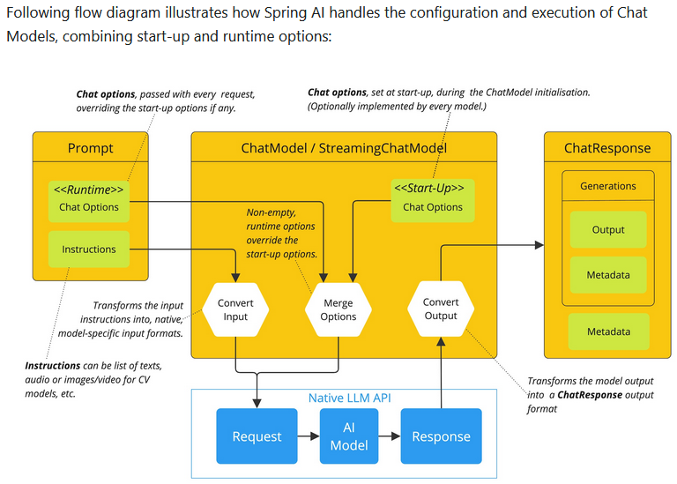

Slide 15
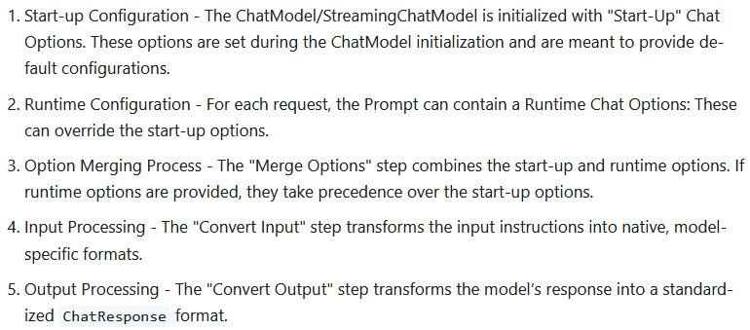

Slide 16
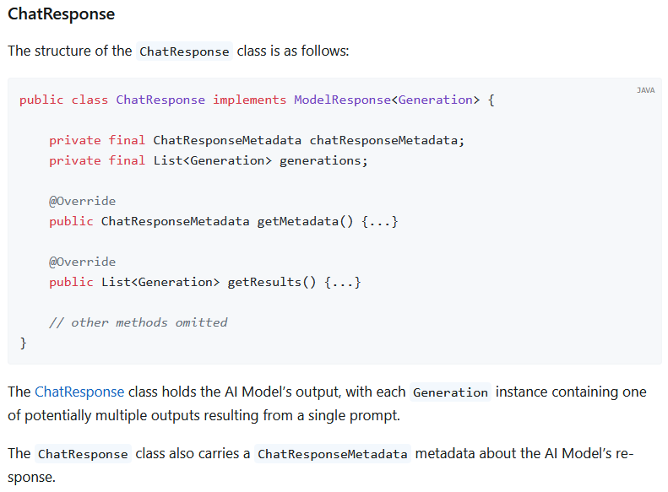

Slide 17
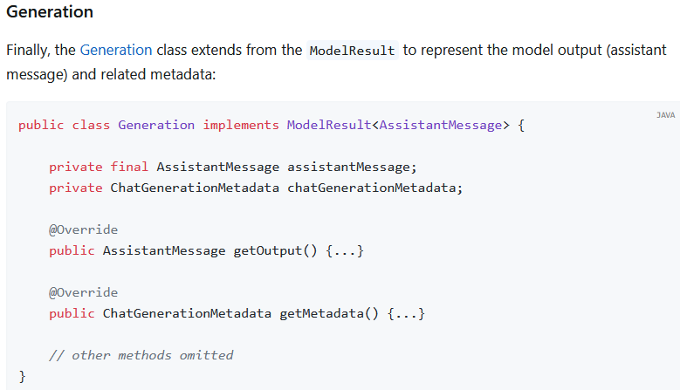

Slide 18
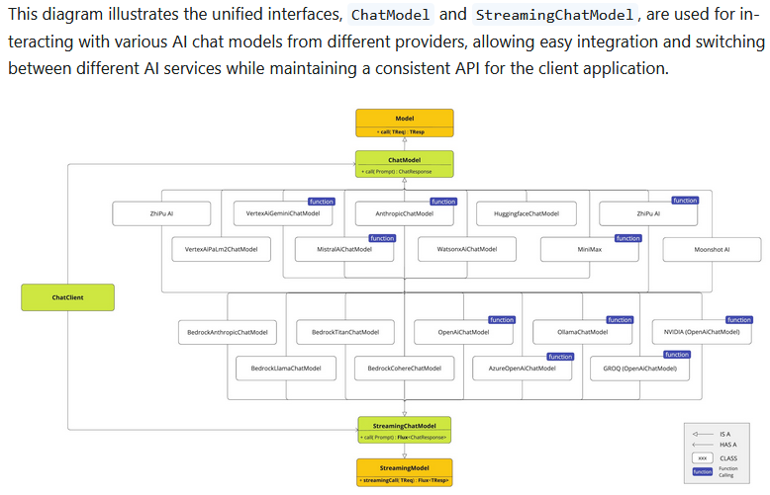

Slide 19
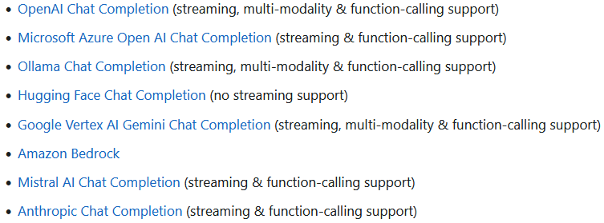

Slide 20
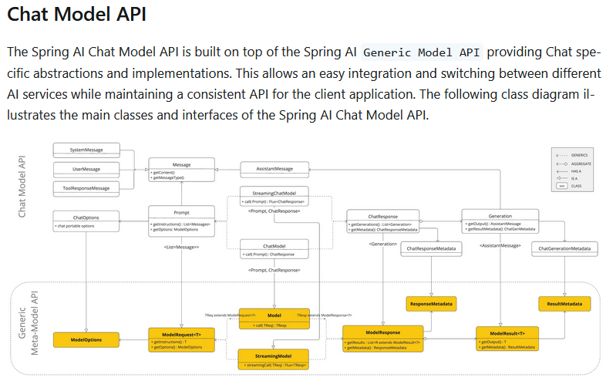

Slide 21
Chat Models Comparison
This table compares various Chat Models supported by Spring AI, detailing their capabilities:
Multimodality: The types of input the model can process (e.g., text, image, audio, video).
Tools/Function Calling: Whether the model supports function calling or tool use.
Streaming: If the model offers streaming responses.
Retry: Support for retry mechanisms.
Observability: Features for monitoring and debugging.
Built-in JSON: Native support for JSON output.
Local deployment: Whether the model can be run locally.
OpenAI API Compatibility: If the model is compatible with OpenAI’s API.

Slide 22
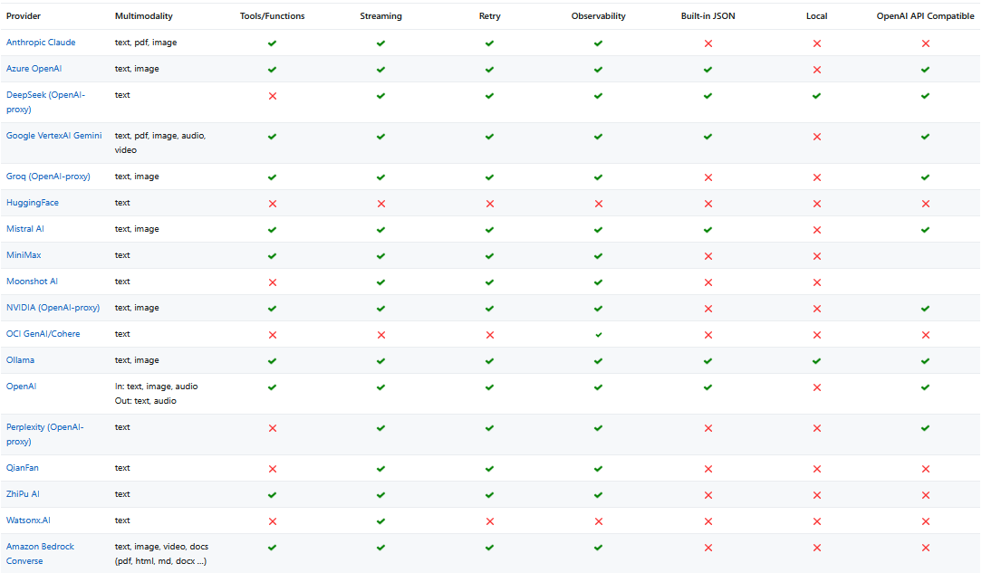

Slide 23
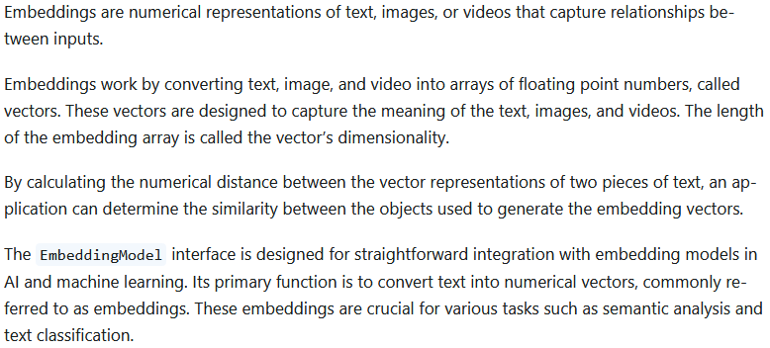
2. Embeddings Model API

Slide 24
Primary Goals
The design of the EmbeddingModel interface centers around two primary goals:
Portability:
This interface ensures easy adaptability across various embedding models.
It allows developers to switch between different embedding techniques or models with minimal code changes.
This design aligns with Spring’s philosophy of modularity and interchangeability.
Simplicity:
EmbeddingModel simplifies the process of converting text to embeddings.
By providing straightforward methods like embed(String text) and embed(Document document), it takes the complexity out of dealing with raw text data and embedding algorithms.
This design choice makes it easier for developers, especially those new to AI, to utilize embeddings in their applications without delving deep into the underlying mechanics.

Slide 25
API Overview
The Embedding Model API is built on top of the generic Spring AI Model API, which is a part of the Spring AI library.
As such, the EmbeddingModel interface extends the Model interface, which provides a standard set of methods for interacting with AI models.
The EmbeddingRequest and EmbeddingResponse classes extend from the ModelRequest and ModelResponse are used to encapsulate the input and output of the embedding models, respectively.
The Embedding API in turn is used by higher-level components to implement Embedding Models for specific embedding models, such as OpenAI, Titan, Azure OpenAI, Ollie, and others.

Slide 26
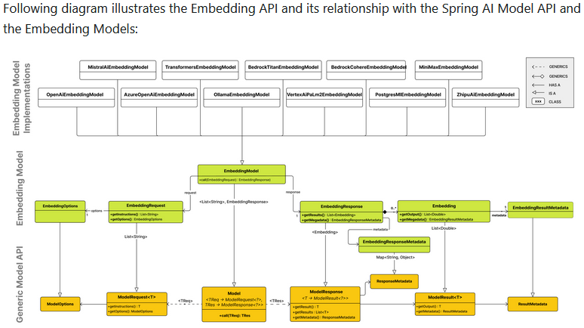

Slide 27
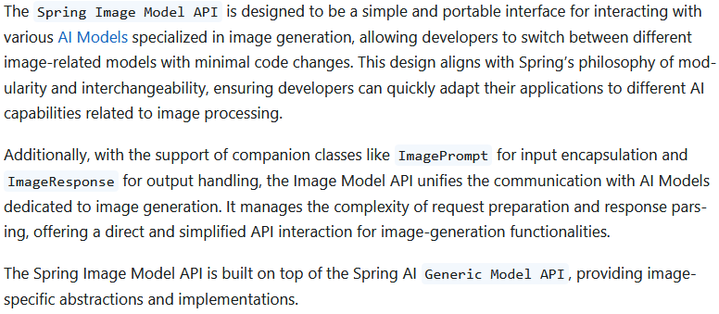
3. Image Model API

Slide 28
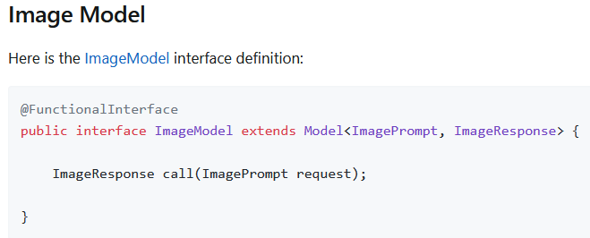

Slide 29
Available Implementations
ImageModel implementations are provided for the following Model providers:
OpenAI Image Generation
Azure OpenAI Image Generation
StabilityAI Image Generation
ZhiPuAI Image Generation

Slide 30
Azure OpenAI Image Generation
Spring AI supports DALL-E, the Image generation model from Azure OpenAI.
Obtain your Azure OpenAI endpoint and api-key from the Azure OpenAI Service section on the Azure Portal.
Spring AI defines a configuration property named spring.ai.azure.openai.api-key that you should set to the value of the API Key obtained from Azure.
There is also a configuration property named spring.ai.azure.openai.endpoint that you should set to the endpoint URL obtained when provisioning your model in Azure.
Exporting environment variables is one way to set these configuration properties:
export SPRING_AI_AZURE_OPENAI_API_KEY=<INSERT KEY HERE>
export SPRING_AI_AZURE_OPENAI_ENDPOINT=<INSERT ENDPOINT URL HERE>

Slide 31
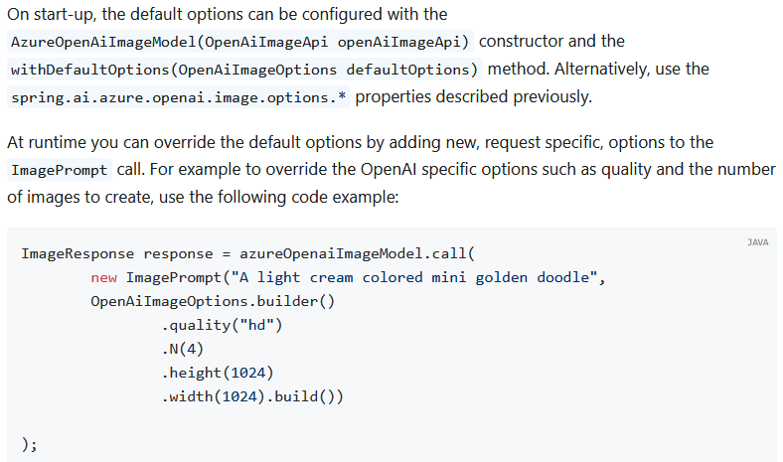

Slide 32
4. Audio Models
Spring AI provides support for OpenAI’s Transcription API.
When additional providers for Transcription are implemented, a common AudioTranscriptionModel interface will be extracted.

Slide 33
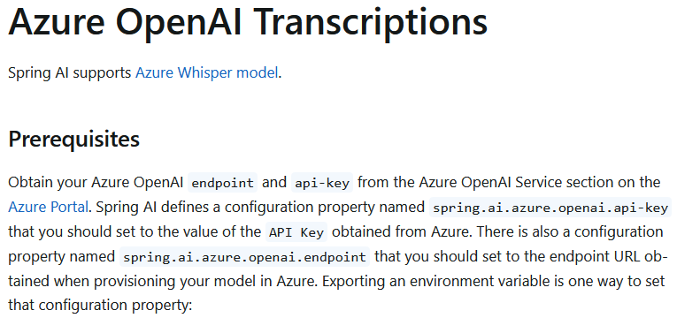

Slide 34
Runtime Options
The AzureOpenAiAudioTranscriptionOptions class provides the options to use when making a transcription. On start-up, the options specified by spring.ai.azure.openai.audio.transcription are used, but you can override these at runtime.

Slide 35
AzureOpenAiAudioTranscriptionOptions.TranscriptResponseFormat responseFormat = AzureOpenAiAudioTranscriptionOptions.TranscriptResponseFormat.VTT;
AzureOpenAiAudioTranscriptionOptions transcriptionOptions = AzureOpenAiAudioTranscriptionOptions.builder().language("en") .prompt("Ask not this, but ask that")
.temperature(0f)
.responseFormat(this.responseFormat)
.build();
AudioTranscriptionPrompt transcriptionRequest = new AudioTranscriptionPrompt(audioFile, this.transcriptionOptions);
AudioTranscriptionResponse response = azureOpenAiTranscriptionModel.call(this.transcriptionRequest);

Slide 36
Next, create a AzureOpenAiAudioTranscriptionModel
var openAIClient = new OpenAIClientBuilder().credential(new AzureKeyCredential(System.getenv("AZURE_OPENAI_API_KEY"))) .endpoint(System.getenv("AZURE_OPENAI_ENDPOINT")).buildClient();
var azureOpenAiAudioTranscriptionModel = new AzureOpenAiAudioTranscriptionModel(this.openAIClient, null);
var transcriptionOptions = AzureOpenAiAudioTranscriptionOptions.builder() .responseFormat(TranscriptResponseFormat.TEXT)
.temperature(0f)
.build();
var audioFile = new FileSystemResource("/path/to/your/resource/speech/jfk.flac");
AudioTranscriptionPrompt transcriptionRequest = new AudioTranscriptionPrompt(this.audioFile, this.transcriptionOptions);
AudioTranscriptionResponse response = this.azureOpenAiAudioTranscriptionModel.call(this.transcriptionRequest);

Slide 37
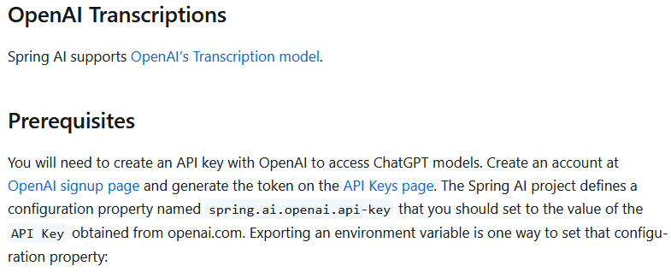

Slide 38
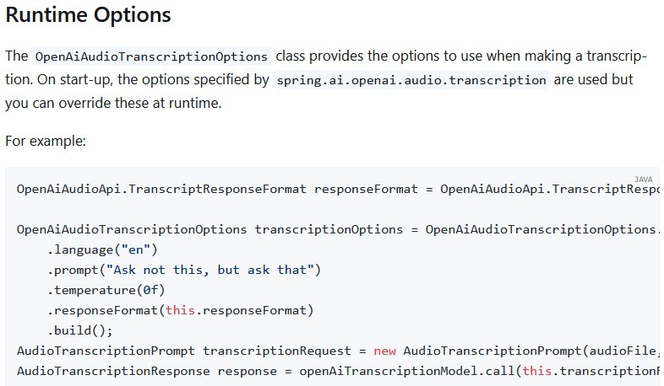

Slide 39
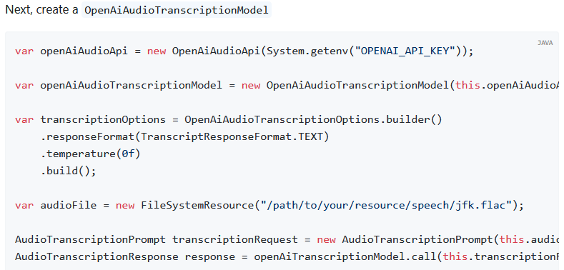

Slide 40
5. Text-To-Speech (TTS) API
Spring AI provides support for OpenAI’s Speech API.
When additional providers for Speech are implemented, a common SpeechModel and StreamingSpeechModel interface will be extracted.

Slide 41
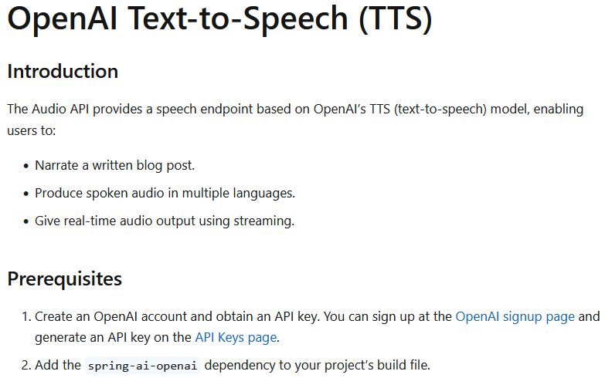

Slide 42
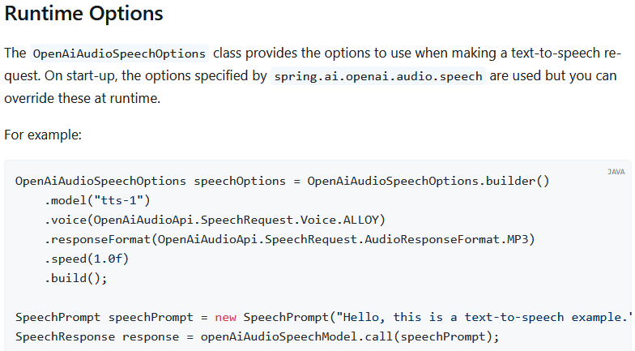

Slide 43
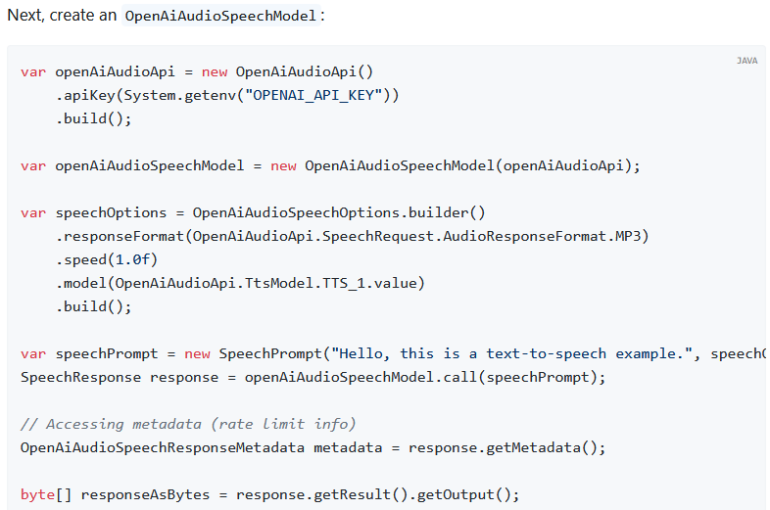

Slide 44
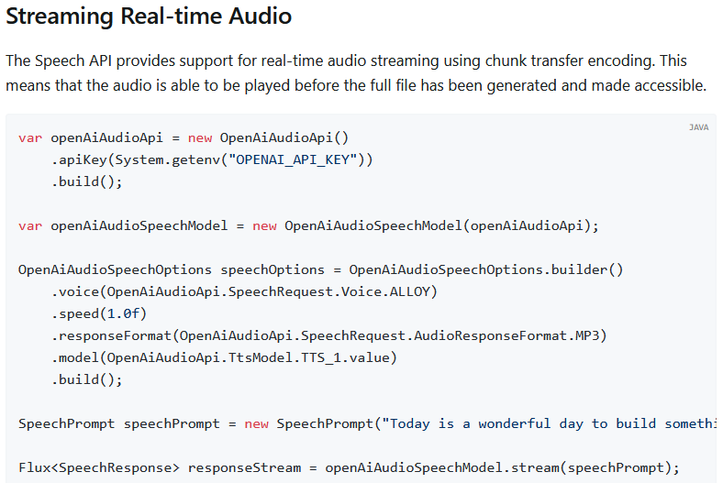

Slide 45
6. Moderation
Spring AI supports OpenAI’s Moderation model, which allows you to detect potentially harmful or sensitive content in text.
Prerequisites
Create an OpenAI account and obtain an API key.
You can sign up at the OpenAI signup page and generate an API key on the API Keys page.
Add the spring-ai-openai dependency to your project’s build file.

Slide 46
Runtime Options
The OpenAiModerationOptions class provides the options to use when making a moderation request.
On start-up, the options specified by spring.ai.openai.moderation are used, but you can override these at runtime.

Slide 47
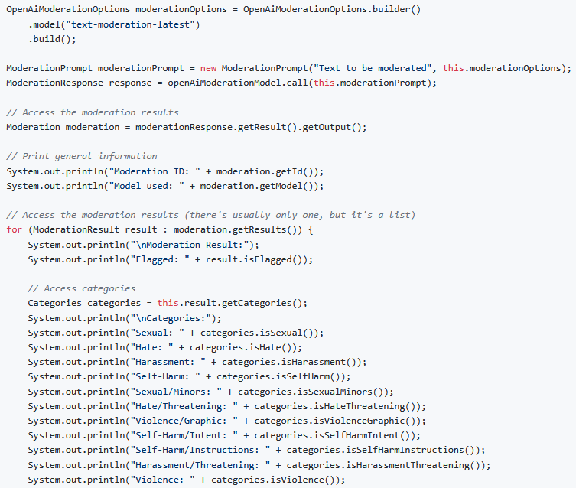

Slide 48
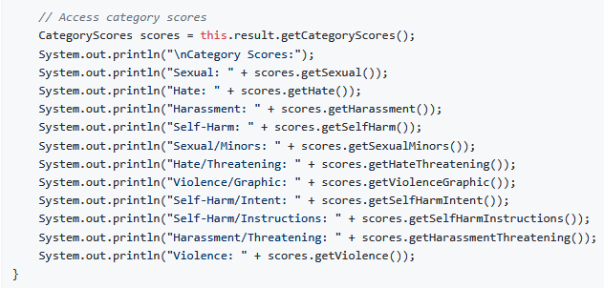

Slide 49
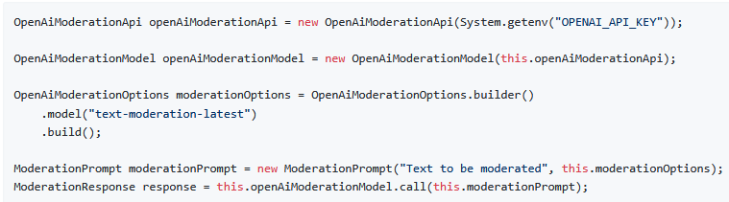
Next, create an OpenAiModerationModel:

